Slide 1

Notes:
Reload codespace
Update settings.json.
Uncheck VS Code tabs except for Terminal
Hide Activity Bar
Hide Explorer
Remove comments from any pre-made code

Slide 2
This is CS50
Visit cs50.ly/screen to view projector on your laptop and ask questions via chat.
Today's snack, fruit snacks and roll-ups!
Last CS50 Lunch this Fri 11/17 at 1:15pm! RSVP at cs50.ly/lunch!
Do say hi or ask questions (or ask for stress ball 🔴) during break or after class!

Slide 4
http-server

Slide 5
https://www.example.com/

Slide 6
https://www.example.com/file.html

Slide 7
https://www.example.com/folder/

Slide 8
https://www.example.com/folder/file.html

Slide 9
https://www.example.com/path

Slide 10
https://www.example.com/route

Slide 11
https://www.example.com/route?key=value

Slide 12
https://www.example.com/route?key=value&key=value
Notes:
https://www.google.com/search?q=cats

Slide 13
GET /search?q=cats HTTP/2
Host: www.google.com
...

Slide 14
Flask

Slide 15
flask run

Slide 16
app.py
requirements.txt
static/
templates/

Slide 17
app.py
requirements.txt
static/
templates/

Slide 18
from flask import Flask, render_template
app = Flask(__name__)
@app.route("/")
def index():
return render_template("index.html")
Notes:
hello0

Slide 19
request.args
Notes:
hello1/

Slide 20
Jinja
Notes:
hello{2,3,4,5}/

Slide 21
request.form
Notes:
hello{6,7}/

Slide 22
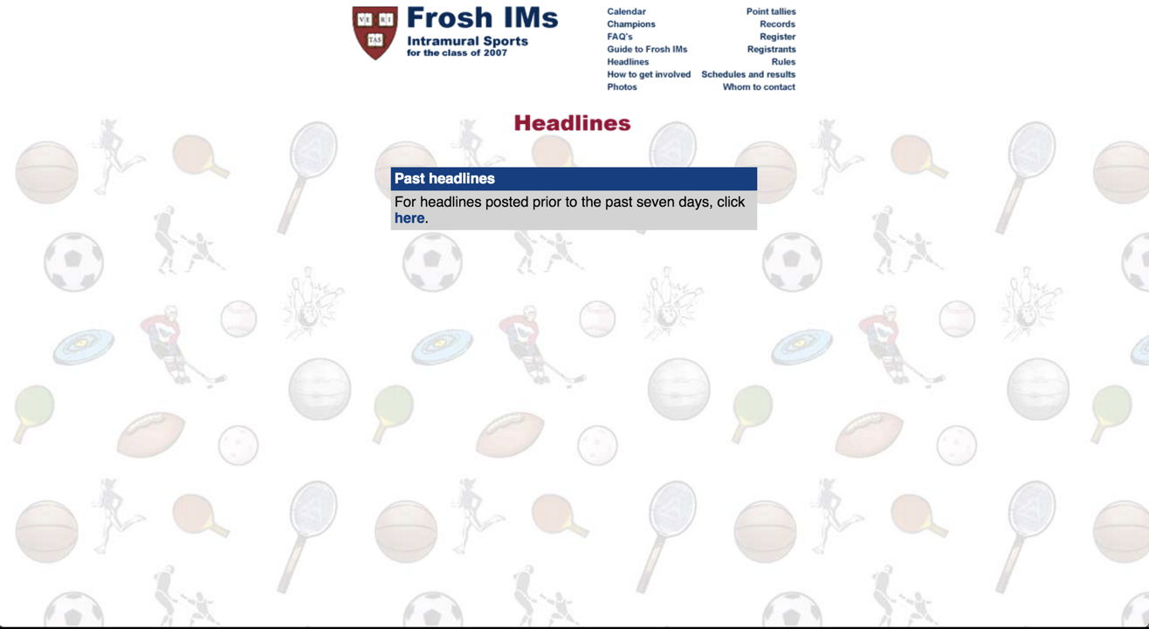
Notes:
froshims{0,1,2,3,4,5}/

Slide 23
Controller
View

Slide 24
Model
Controller
View

Slide 25
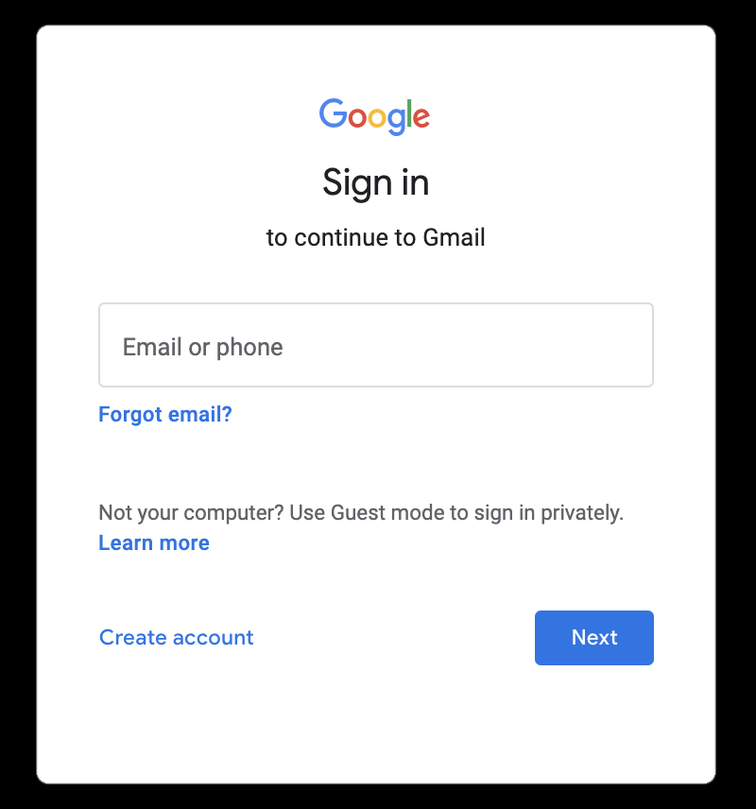

Slide 26
GET / HTTP/2
Host: accounts.google.com
...

Slide 27
HTTP/2 200
Content-Type: text/html
...

Slide 28
HTTP/2 200
Content-Type: text/html
Set-Cookie: session=value
...

Slide 29
GET / HTTP/2
Host: accounts.google.com
...

Slide 30
GET / HTTP/2
Host: accounts.google.com
Cookie: session=value
...
Notes:
hand stamp

Slide 31
session
Notes:
login/
store/

Slide 32
from cs50 import SQL

Slide 33
[
{"id": 1, "title": "The Hitchhiker's Guide to the Galaxy"},
{"id": 2, "title": "The Restaurant at the End of the Universe"},
{"id": 3, "title": "Life, the Universe and Everything"},
{"id": 4, "title": "So Long, and Thanks for All the Fish"},
{"id": 5, "title": "Mostly Harmless"},
]

Slide 34
API
Notes:
shows0/

Slide 35
[
{"id": 112108, "title": "The Office", "year": 1995, "episodes": 6},
{"id": 290978, "title": "The Office", "year": 2001, "episodes": 14},
{"id": 386676, "title": "The Office", "year": 2005, "episodes": 188},
{"id": 1791001, "title": "The Office", "year": 2010, "episodes": 30},
{"id": 2186395, "title": "The Office", "year": 2012, "episodes": 8},
{"id": 8305218, "title": "The Office", "year": 2019, "episodes": 28},
{"id": 20877972, "title": "The Office", "year": 2022, "episodes": 20},
]
Notes:
shows1/
shows2/ [show existing code]

Slide 36
JSON
Notes:
shows3/ [show existing code]

Slide 37
[
{"id": 112108, "title": "The Office", "year": 1995, "episodes": 6},
{"id": 290978, "title": "The Office", "year": 2001, "episodes": 14},
{"id": 386676, "title": "The Office", "year": 2005, "episodes": 188},
{"id": 1791001, "title": "The Office", "year": 2010, "episodes": 30},
{"id": 2186395, "title": "The Office", "year": 2012, "episodes": 8},
{"id": 8305218, "title": "The Office", "year": 2019, "episodes": 28},
{"id": 20877972, "title": "The Office", "year": 2022, "episodes": 20}
]
Notes:
no trailing comma

